Slide 1
Doubly Linked Lists
Data Structures & Algorithms

Slide 2
Node data
info: the user's data
next, back: the address of the next and previous node in the list
.back
.info
.next

Slide 3
Node data (cont.)
template<class ItemType>
struct NodeType {
ItemType info;
NodeType<ItemType>* next;
NodeType<ItemType>* back;
};

Slide 4
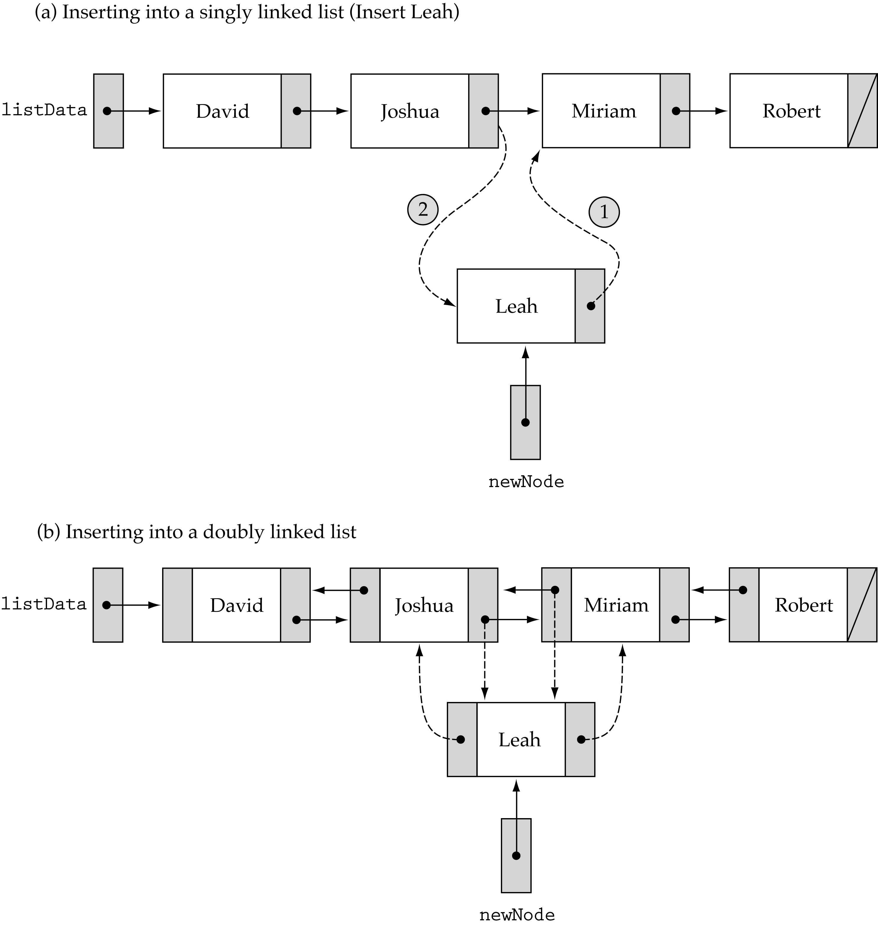
Finding a List Item
We no longer need to use prevLocation (we can get the predecessor of a node using its back member)

Slide 5
Finding a List Item (cont.)

Slide 6
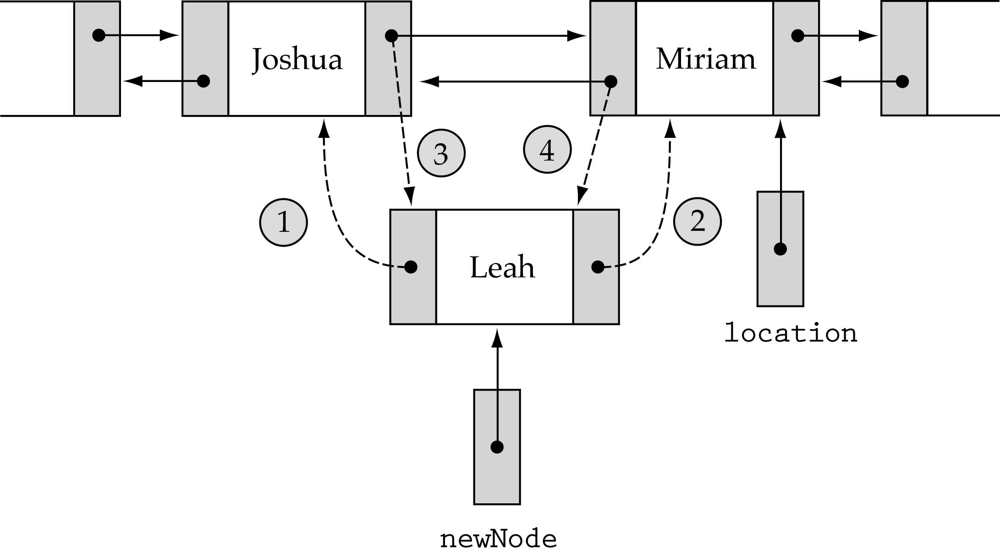
Inserting into a Doubly Linked List
1. newNode->back = location->back; 3. location->back->next=newNode;
2. newNode->next = location 4. location->back = newNode;

Slide 7
FindItem(listData, item, location, found)
RetrieveItem, InsertItem, and DeleteItem all require a search !
Write a general non-member function FindItem that takes item as a parameter and returns location and found.
InsertItem and DeleteItem need location (ignore found)
RetrieveItem needs found (ignores location)

Slide 8
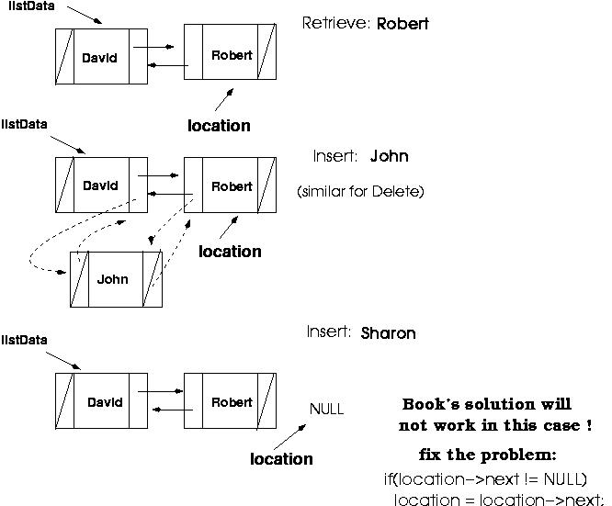

Slide 9
Finding a List Item (cont.)
template<class ItemType>
void FindItem(NodeType<ItemType>* listData, ItemType item,
NodeType<ItemType>* &location, bool &found)
{
// precondition: list is not empty
bool moreToSearch = true;
location = listData;
found = false;
while( moreToSearch && !found) {
if(item < location->info)
moreToSearch = false;
else if(item == location->info)
found = true;
else {
if(location->next == NULL)
moreToSearch = false;
else
location = location->next;
}
}
}

Slide 10
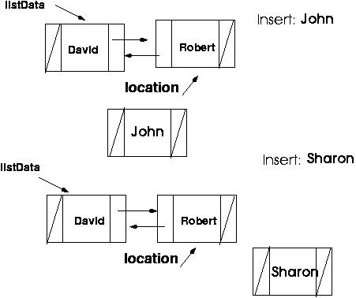
How can we distinguish between the following two cases?

Slide 11
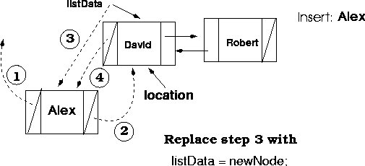
Special case: inserting in the beginning

Slide 12
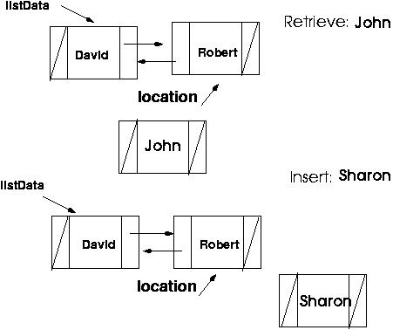
Inserting into a Doubly Linked List
template<class ItemType>
void SortedType<ItemType>::InsertItem(ItemType item)
{
NodeType<ItemType>* newNode;
NodeType<ItemType>* location;
bool found;
newNode = new NodeType<ItemType>;
newNode->info = item;
if (listData != NULL) {
FindItem(listData, item, location, found);
if (location->info > item) {
newNode->back = location->back;
newNode->next = location;
if (location != listData) // special case
(location->back)->next = newNode;
else
listData = newNode;
location->back = newNode;
}
(3)
(4)
(1)
(2)
(3)

Slide 13
Inserting into a Doubly Linked List (cont.)
else { // insert at the end
newNode->back = location;
location->next = newNode;
newNode->next = NULL;
}
}
else { // insert into an empty list
listData = newNode;
newNode->next = NULL;
newNode->back = NULL;
}
length++;
}

Slide 14
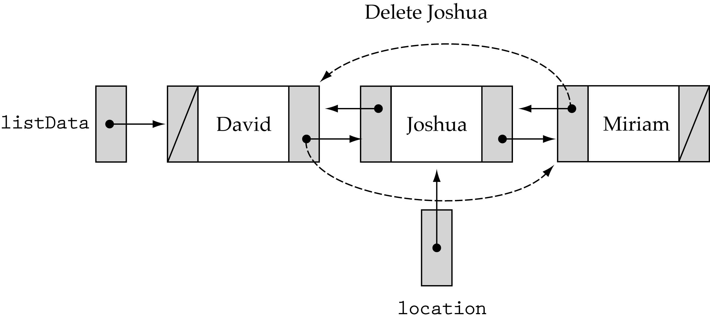
Deleting from a Doubly Linked List
Be careful about the end cases!!

Slide 15
Headers and Trailers
Special cases arise when we are dealing with the first or last nodes
How can we simplify the implementation?
Idea: make sure that we never insert or delete the ends of the list
How? Set up dummy nodes with values outside of the range of possible values

Slide 16
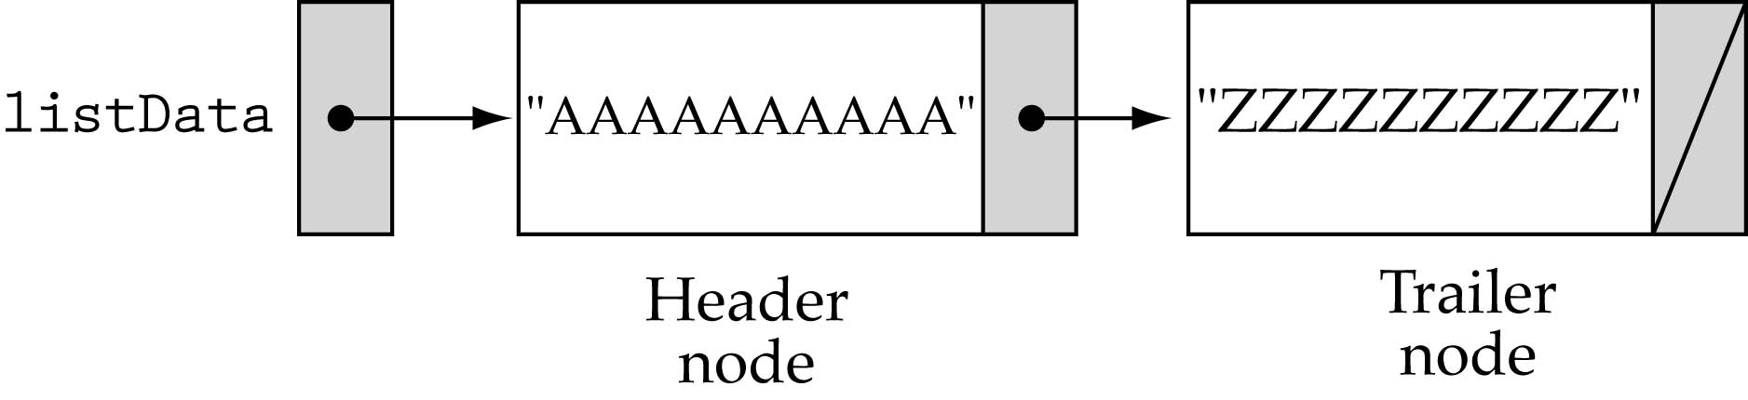
Headers and Trailers (cont.)
Header Node: contains a value smaller than any possible list element
Trailer Node: contains a value larger than any possible list element

Slide 17
A linked list as an array of records
What are the advantages of using linked lists?
(1) Dynamic memory allocation
(2) Efficient insertion-deletion (for sorted lists)
Can we implement a linked list without dynamic memory allocation ?

Slide 18
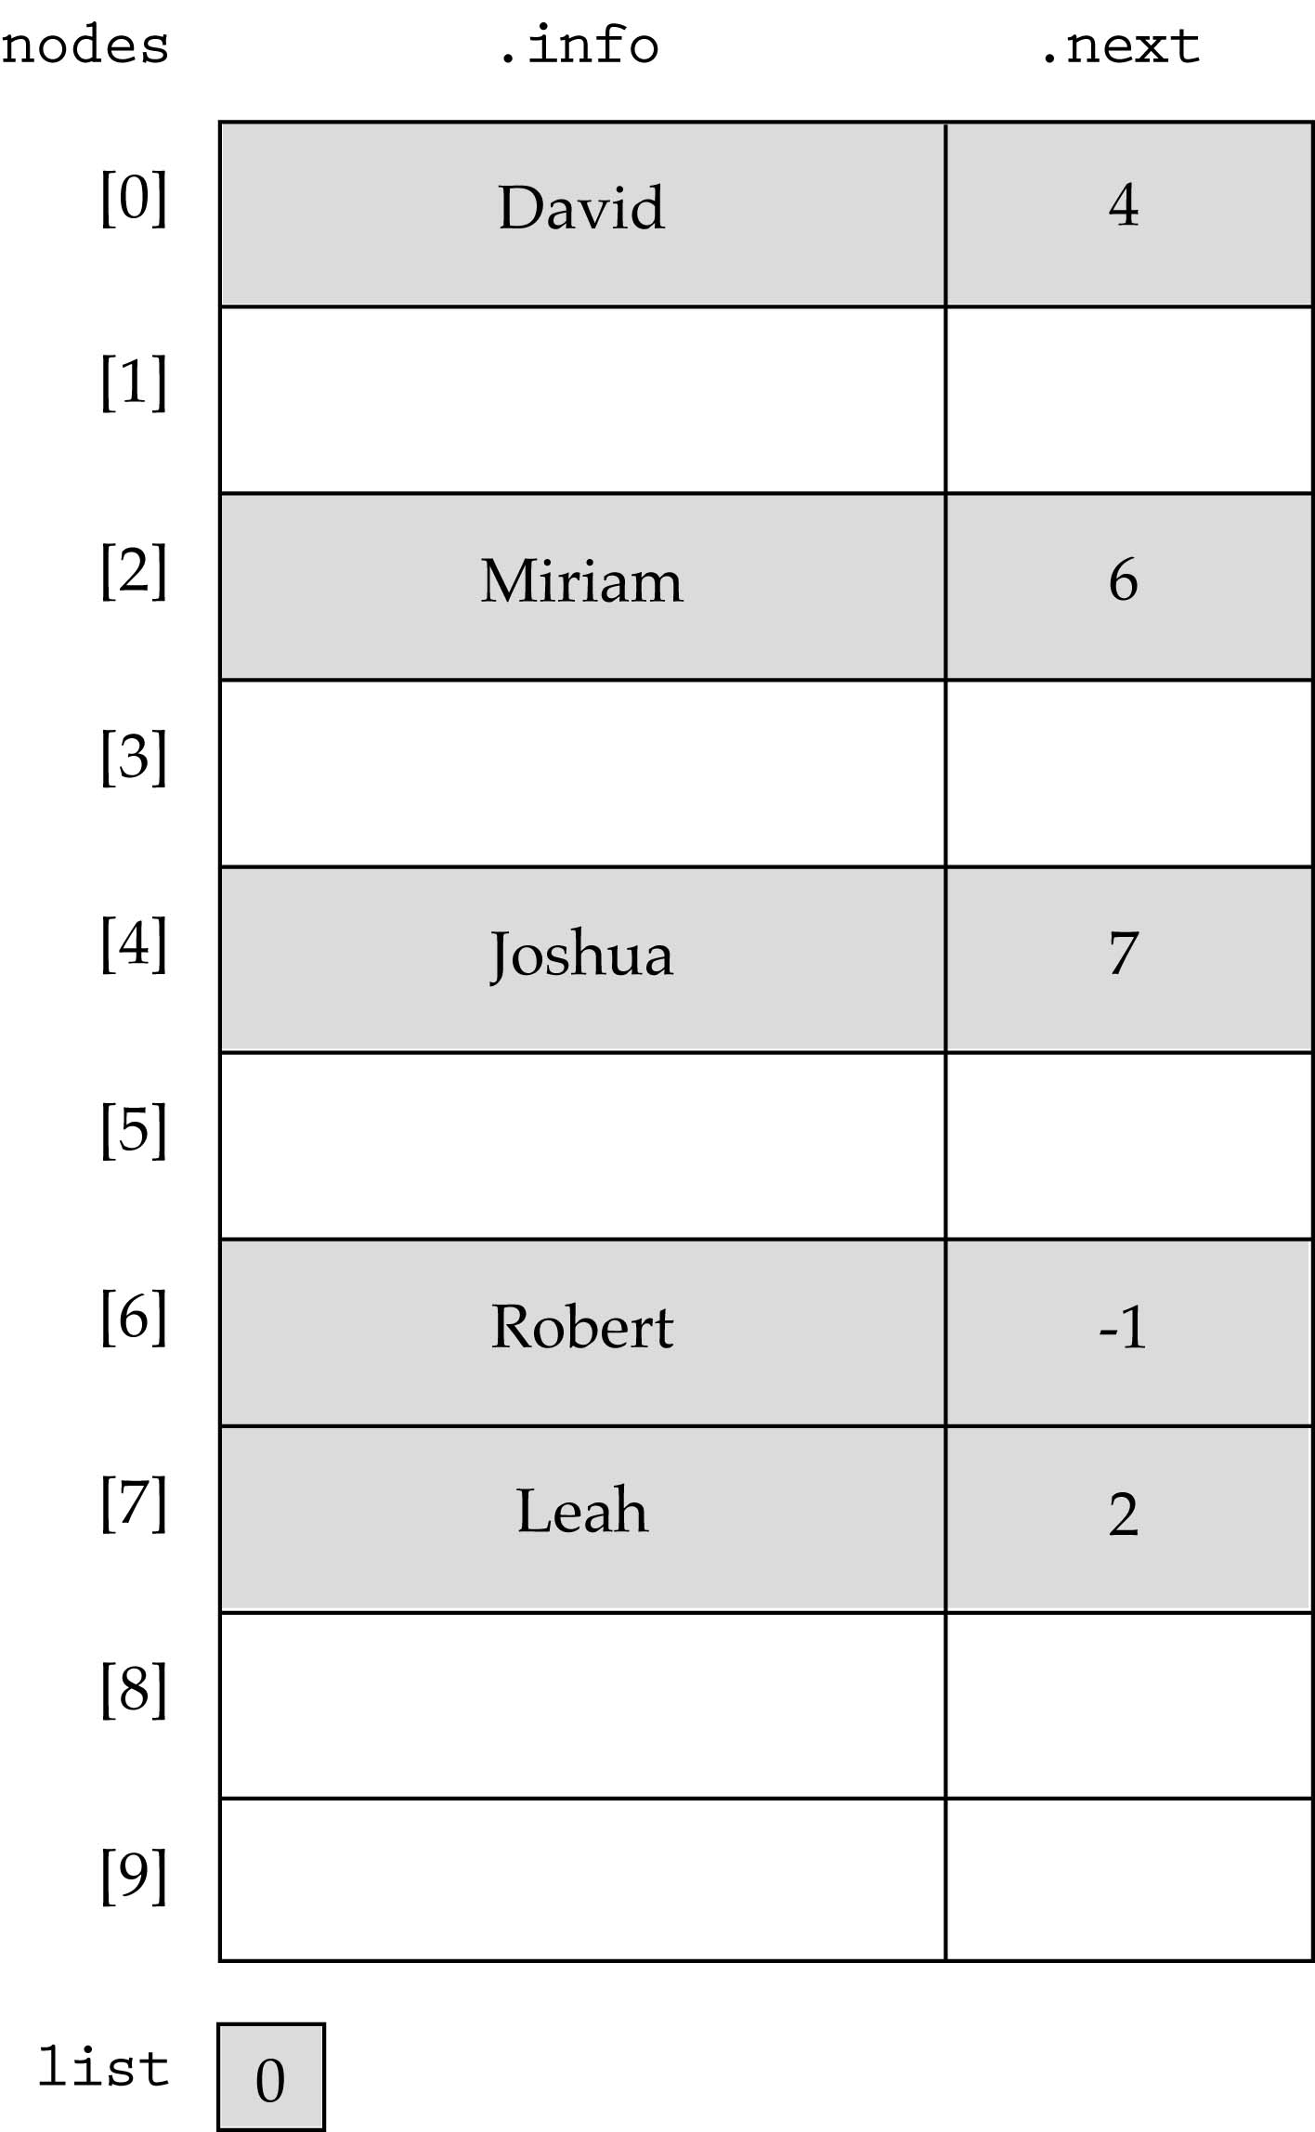
A linked list as an array of records (cont.)

Slide 19
Case Study: Implementing a large integer ADT
The range of integer values varies from one computer to another
For long integers, the range is
[-2,147,483,648 to 2,147,483,647]
How can we manipulate larger integers?

Slide 20
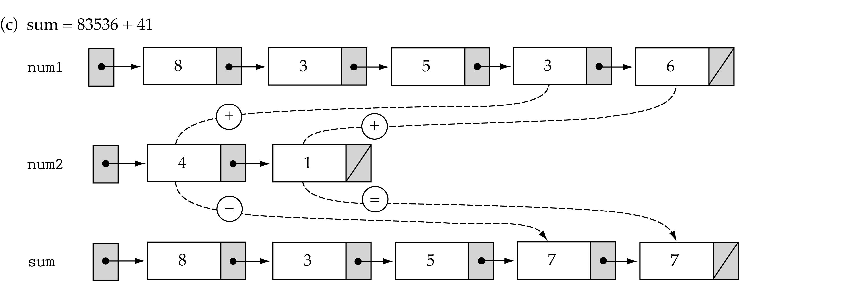
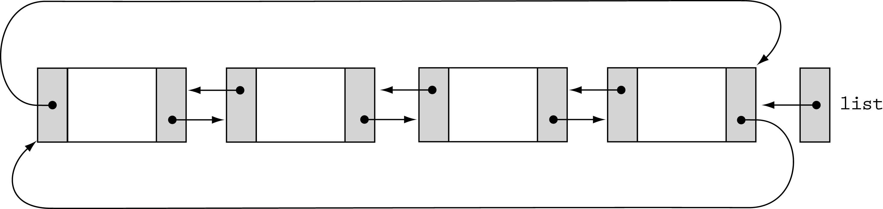
Case Study: Implementing a large integer ADT (cont.)
- A special list ADT

Slide 21
Exercises

